Slide 1
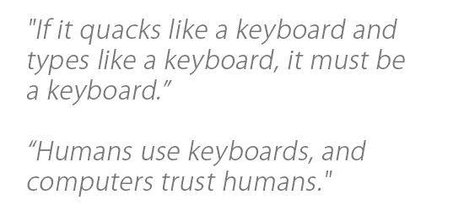
Required Materials
1 Windows PC (Windows 7 or newer)
Internet Access
USB Rubber Ducky (can be obtained from staff)
MicroSD to USB reader (can be obtained from staff)
WARNING! DO NOT plug in Rubber Ducky directly to your machine. First check the MicroSD card using card reader, ‘right click’ on drive and select ‘quick format’, then click ‘start.’ You do not know who was using this device before you, or what payload may remain.
ENJOY USING THE RUBBER DUCKY
Estimated Time to Complete: 15 min

Slide 2
Ethics – Doing the Right Thing
The information and skills learned and taught in this lab can wrongfully be used for malicious purposes.
Never Forget cyber attacks/hacks no matter the intent are a serious crime, you can go to Federal prison!
(ISC)2 Code of ethics
-Protect society, the commonwealth, and the infrastructure.
-Act honorably, honestly, justly, responsibly, and legally.
-Provide diligent and competent service to principals.
-Advance and protect the profession.

Slide 3
What is Rubber Ducky?
The USB Rubber Ducky is a very powerful keystroke injection tool disguised as a generic flash drive. Computers recognize it as a regular keyboard and accept pre-programmed keystroke payloads at over 1000 words per minute.
Payloads can be created using a simple scripting language and can be used to inject binaries (i.e., compiled program code), brute force pin codes, and many other automated functions for penetration testing
Every computer (Desktop, Laptops, Tablets & Smartphones) takes inputs from the keyboard. Because the computer views the Rubber Ducky device as an input device (i.e., Keyboard), the program code that is resident in a file stored in the Rubber Ducky is treated as input to the compiler. This is why the Rubber Ducky USB device, which works as a Human Interface Device (HID) is automatically detected by most modern operating systems. By taking the advantage of this, one can penetrate the computer.

Slide 4
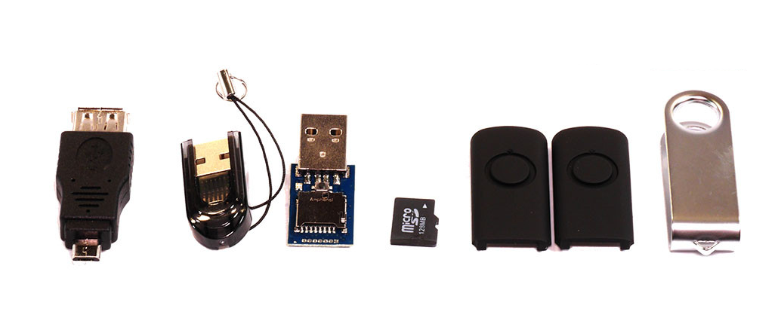
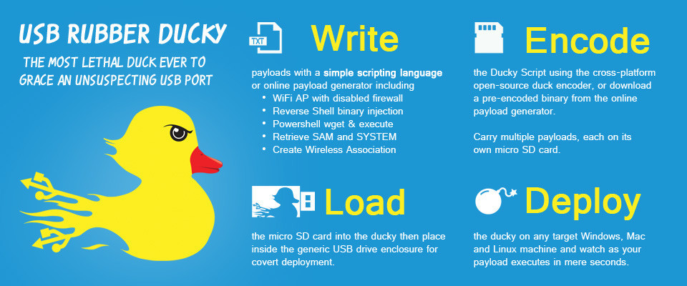
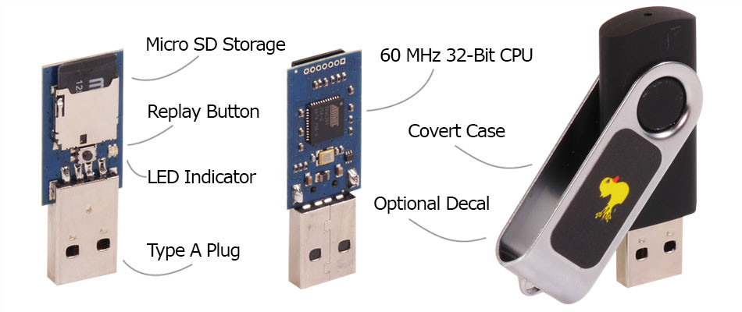
Rubber Ducky USB device

Slide 5
Ducky’s scripting language
To write a payload, one needs to use a text editor, such as Notepad.exe, MSWord.exe, or any other Text Editor. Using the Text Editor, one can create code that is used by the Rubber Ducky to serve as input to the computer.
Enter the following program code into a file named ‘Ducky.txt’, or any other name one choses and save to a temporary file on the computer, such as ( /tmp/Ducky1.txt).
Example:
DELAY 1000 <‘DELAY’ adds pause between the commands in milliseconds>
GUI r <It takes you to the ‘RUN’>
DELAY 100
STRING notepad <‘STRING’ prints the message>
ENTER <It will open the Notepad>
DELAY 100
STRING ‘Hello World! I’m in your device’

Slide 6
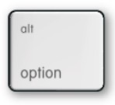




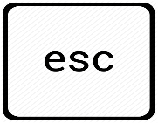


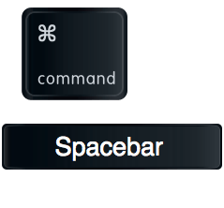
Ducky’s scripting language
‘REM’ – Used to comment your code
Combined special keys for
Windows
- ALT
- CONTROL / CTRL
- ESCAPE / ESC
- GUI r
- SHIFT TAB
Combined special keys for
Mac OS
- OPTION
- COMMAND
- ESCAPE
- COMMAND + SPACE
- SHIFT TAB

Slide 7
References
https://ducktoolkit.com/ = To encode your payloads for Ducky use this encoder
https://github.com/hak5darren/USB-Rubber-Ducky/wiki/Payloads = Numbers of pre-encoded payloads for Ducky available here
https://www.hak5.org/ = Numbers of tutorials available for Rubber Ducky
https://forums.hak5.org/index.php?/forum/56-usb-rubber-ducky/ = Rubber Ducky Forum

Slide 8
What’s next?
Can you think of how to create a script when you can’t use the mouse?
Every Ducky script must be created with this principle in mind.
Make sure that you are thinking about every single keystroke.

